Slide 1
Taxonomy of Factors for Lifetime Buy
Connor Jennings and Janis Terpenny
Iowa State University

Slide 2
Motivation
Rapid growth of the electronics industry.
Quicker introductions of superior components
The U.S. Department of Defense, in 2006, estimated cost of obsolescence and obsolescence mitigation to be $10 billion annually.
The unpredictable nature of obsolescence causes firms to take reactive approaches to solve their problems.
1

Slide 3
Introduction to Lifetime Buy
The most common approach is Lifetime Buy/Last Buy.
Definition: A lifetime buy is when a firm places one last large order for the obsolete component to create a stockpile that the firm will then use to continue the product’s life cycle undisturbed.
2

Slide 4
Problems in Lifetime Buy
Currently many firms only use product demand to forecast the need of the obsolete component.
Neglecting other possible needs for the obsolete component.
No organization of all factors to take into account.
3

Slide 5
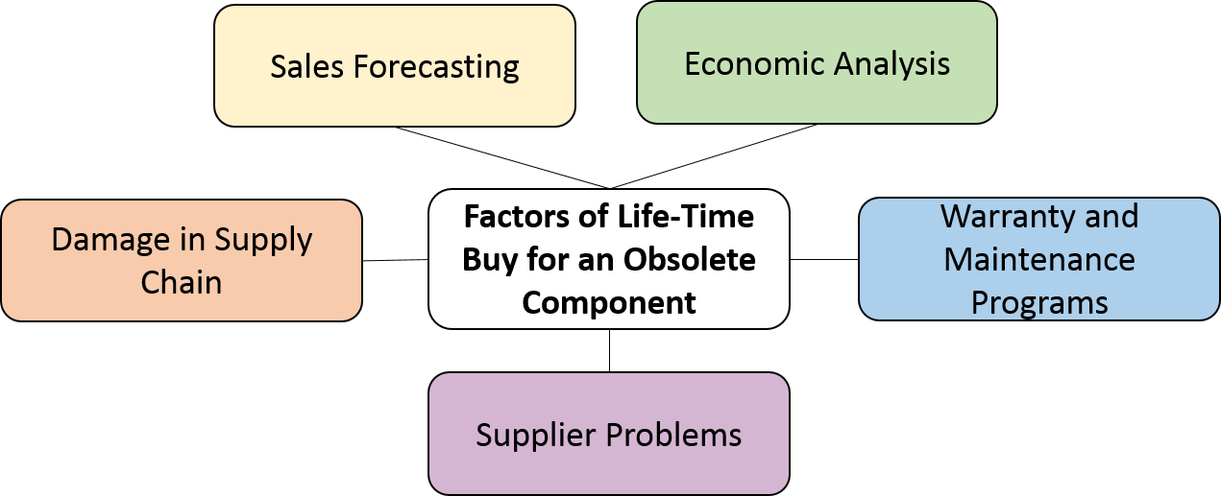
Five Key Areas of the Taxonomy
4

Slide 6
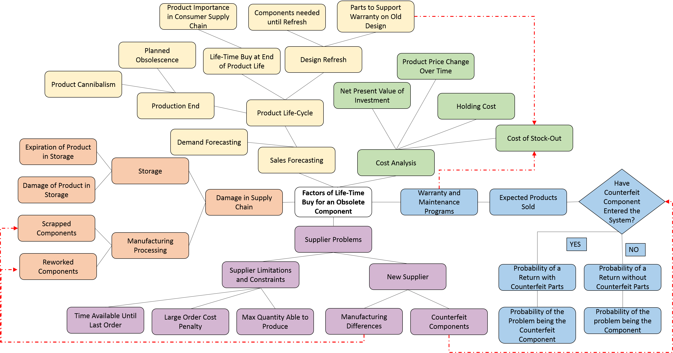
The Relational Factor Taxonomy
Line Key:
Relationship with-in one of the five factors
Relationship in-between two of the five factors
5

Slide 7
Sales Forecasting
Sales Forecasting
Demand Forecasting
Product Life-Cycle
Design Refresh
Production End
Life-Time Buy at End of Product Life
Components needed until Refresh
Parts to Support Warranty on Old Design
Product Cannibalism
Planned Obsolescence
Product Importance in Consumer Supply Chain
6

Slide 8
Irreversible Damage in Supply Chain
Damage in Supply Chain
Manufacturing Processing
Storage
Scrapped Components
Reworked Components
Damage of Product in Storage
Expiration of Product in Storage
7

Slide 9
Supplier Problems
Supplier Problems
Supplier Limitations and Constraints
New Supplier
Time Available Until Last Order
Large Order Cost Penalty
Max Quantity Able to Produce
Manufacturing Differences
Counterfeit Components
Scraped Components
Reworked Components
8

Slide 10
Warranty and Maintenance Programs
Warranty and Maintenance Programs
Have Counterfeit Component Entered the System?
Expected Products Sold
Sales Forecasting
Counterfeit Components
YES
NO
Probability of a Return with Counterfeit Parts
Probability of a Return without Counterfeit Parts
Probability of the Problem being the Counterfeit Component
Probability of the problem being the Component
9

Slide 11
Economic Analysis
Cost Analysis
Product Price Change Over Time
Net Present Value of Investment
Holding Cost
Cost of Stock-Out
Warranty and Maintenance Programs
Parts to Support Warranty on Old Design
10

Slide 12
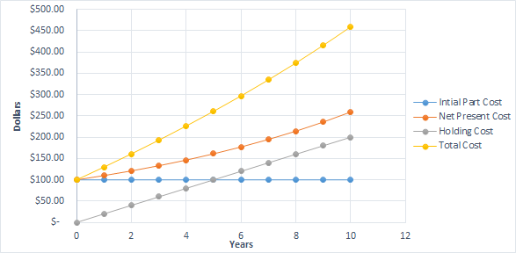
Economic Analysis
Part with Original Cost of $100
Annual Holding Cost of 20% of Part Cost
A Discount Rate of 10%
Lifetime Buy Costs over Time
11

Slide 13
Conclusion
Many factors determine life time buy quantities
Only estimating lifetime buy quantities based on the demand of the product can underestimate the parts needed.
A thorough economic analysis to understand the true cost of the lifetime buy.
12

Slide 14
Future Work
Life Time Buy Risk Simulations
Economic Analysis Models
Decisions Models to pick between obsolescence mitigation strategies.
13

Slide 15

Thank you!
This work was funded by the National Science Foundation through Grant Nos. 0928530, 0928628, 0928837, and 1238335 . Any opinions, findings, and conclusions or recommendations presented in this paper are those of the authors and do not necessarily reflect the views of the National Science Foundation.
14

